Slide 1
SHOPPING
SOR

Slide 2

Smart Shopping: Style, Savings, and Sustainability
Introduction
Shopping is an important part of teenagers’ lives. It affects our style, finances, and the environment. This magazine will give you tips, product reviews, and eco-friendly ideas for smarter shopping
Smart Teen Shopping: Choices for the Future
A Teen Magazine – Learn how to shop wisely, save money, and protect the planet.

Slide 3

Style
Fashion and Teens
Fashion is important for teenagers. Clothes and accessories help us show our personality. But we should choose items that are comfortable, long-lasting, and not just trendy. Mixing style with practicality is the key to smart shopping.
Fashion helps teenagers express themselves.
Today, many teens mix new trends with second-hand clothes. This is called smart fashion.
It is not about buying the most expensive brands, but about finding a style that shows your personality.

Slide 4
Saving Money While Shopping
Shopping can be expensive, but teenagers can learn to save:
Use mobile apps to compare prices.
Buy clothes during end-of-season sales.
Swap clothes with friends instead of buying new ones.
Remember: every dollar saved can be used for something more important.
Many teens spend too much money on clothes, gadgets, or snacks. Here are some tips for saving money:
- Compare prices online before buying.
- Wait for discounts or sales.
- Use coupons and promo codes.
- Set a budget and stick to it.

Slide 5
Sustainability
Shopping also affects our planet. Fast fashion and plastic waste damage the environment. You can make eco-friendly choices:
- Use reusable bags instead of plastic.
- Buy second-hand clothes.
- Support eco-friendly and fair-trade brands.
Our choices affect the environment. Teenagers can help the Earth by:
Buying fewer but better clothes.
Choosing eco-friendly materials like cotton and bamboo.
Donating clothes instead of throwing them away.
Supporting local shops instead of fast-fashion brands.

Slide 6
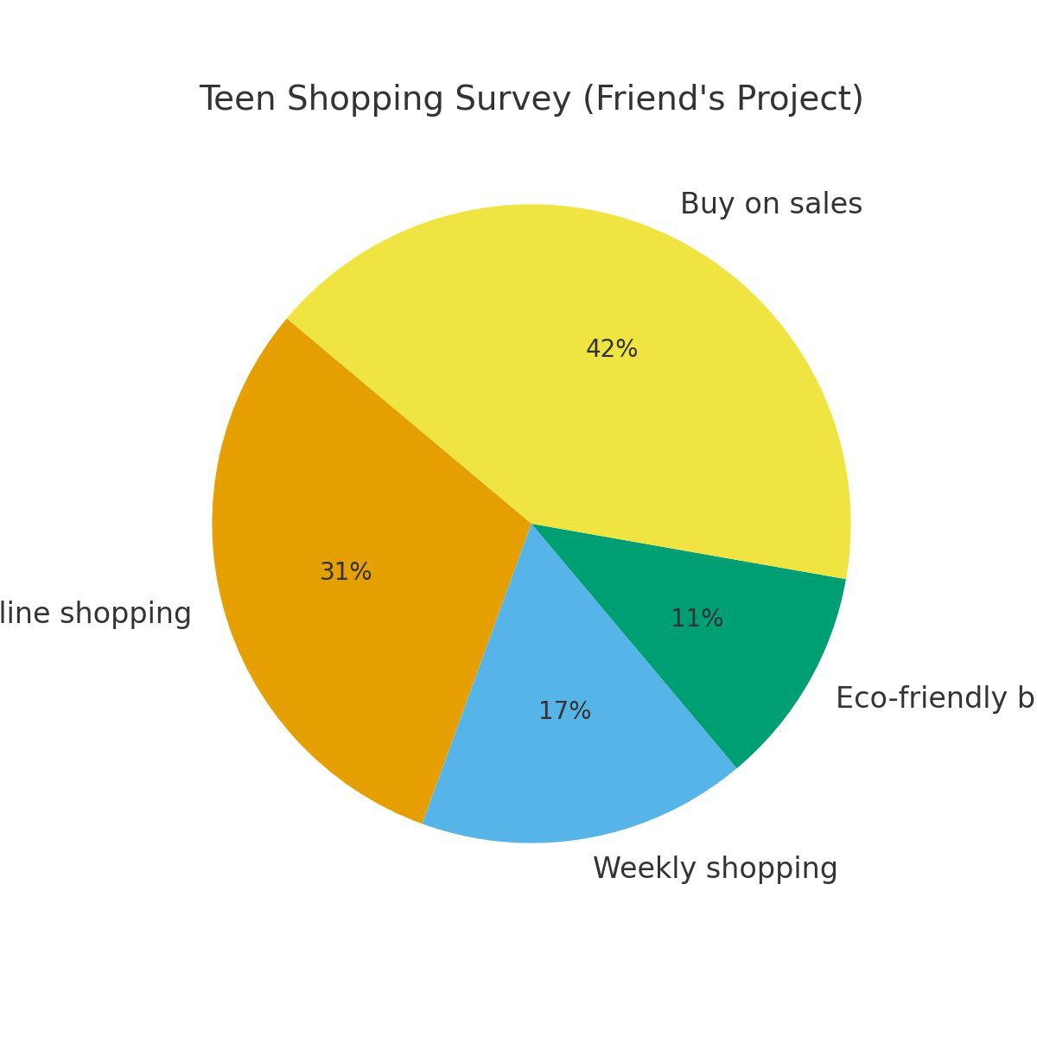
Product Review
Teen Shopping Survey
Do’s:
✔️ Make a list.
✔️ Set a budget.
✔️ Look for discounts.
✔️ Choose long-lasting products.
Don’ts:
✘ Don’t shop only for trends.
✘ Don’t waste money on things you don’t need.
✘ Don’t forget about the environment.
We interviewed 40 teens about shopping:
55% prefer online shopping.
30% said they shop once a week.
20% focus on eco-friendly brands.
75% buy when there are sales.

Slide 7
Conclusion
Smart shopping means balancing style, savings, and sustainability. Every teenager can make a difference by making smarter choices when shopping.

